Slide 1
Genetic Classification Project

Slide 2
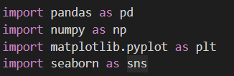
IMPORTING LIBRARIERS
import pandas as pd: This line imports the pandas library and assigns it the alias pd.
import numpy as np: This line imports the numpy library and assigns it the alias np.
import matplotlib.pyplot as plt: This line imports the matplotlib.pyplot module and assigns it the alias plt.
import seaborn as sns: This line imports the seaborn library and assigns it the alias sns

Slide 3
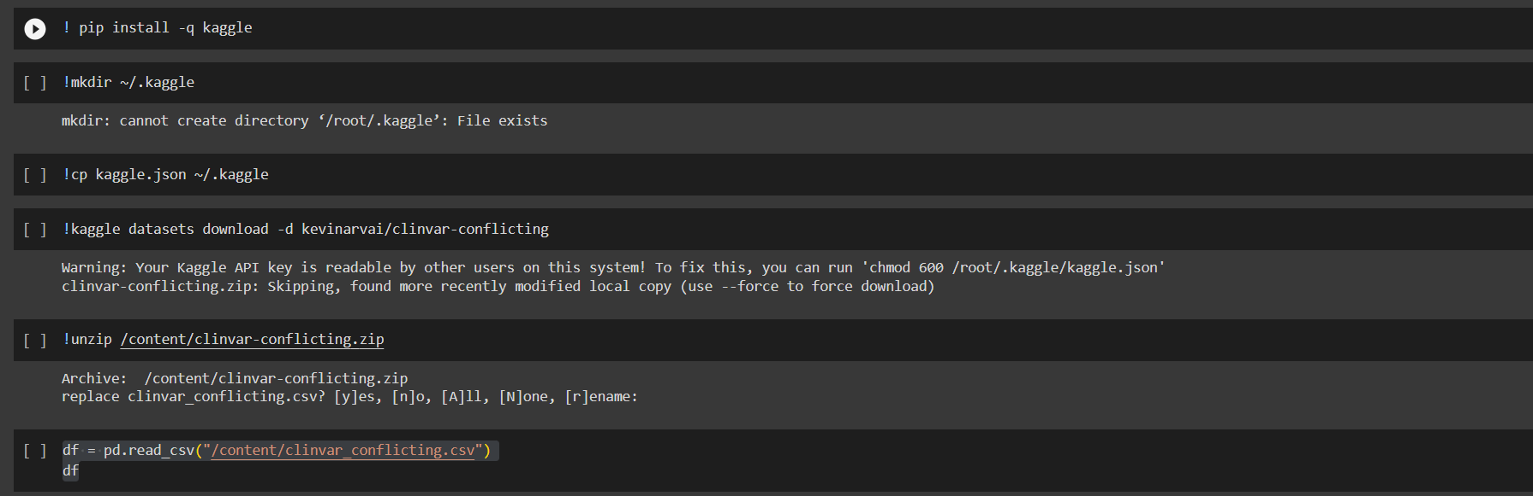
Displaying DataFrame
This code reads a CSV file named clinvar_conflicting.csv and stores its contents in a pandas DataFrame object named df. The pd.read_csv() function is used to read the CSV file, and the resulting DataFrame is then printed to the console using the df variable. The df variable is used to reference the DataFrame object throughout the rest of the code. The contents of the DataFrame can be manipulated and analyzed using various pandas functions and methods.

Slide 4
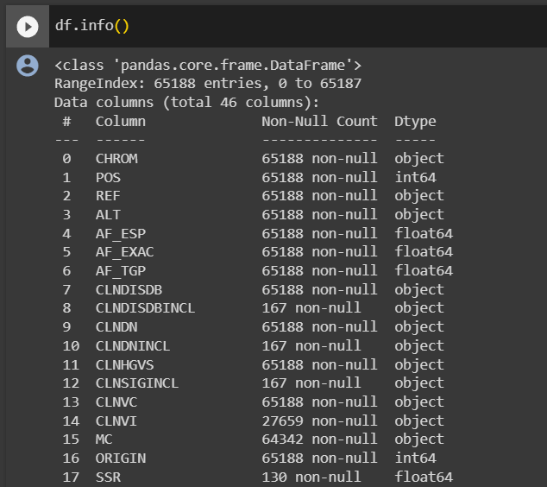
df.info() is a method in pandas that provides a concise summary of a DataFrame. It displays information about the DataFrame, including the number of non-null values in each column, the data type of each column, and the amount of memory used by the DataFrame. This method is useful for quickly understanding the structure and contents of a DataFrame
It has totally 46 columns filled with different data. The Non-Null Count indicates the number of non null values in each column and the Dtype columns indicates the data type of each column

Slide 5
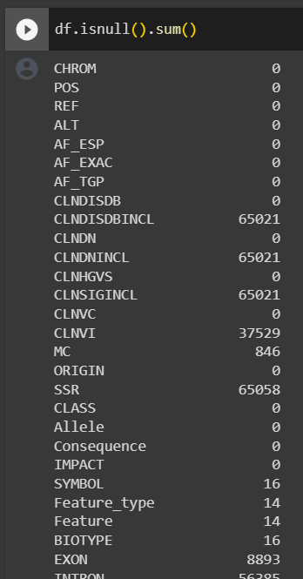
DATA CLEANING Data cleaning is the process of cleaning up and correcting errors in data to ensure it is accurate and reliable for analysis and modeling.
The code df.isnull().sum() is used to check for missing values (NaNs) in a DataFrame df and return the number of missing values in each column. The .isnull() method returns a DataFrame where each cell is True if the corresponding value in the original DataFrame is NaN and False otherwise. The .sum() method then computes the sum of the values in each column, which is the number of NaNs in that column.
The numbers you see in the output are counts or frequencies of different data elements. For example, the number 65,021 in the CLNDISDBINCL column indicates that there are 65,021 variants in the data set that have been called in the ClinVar database and that are included in other variant databases. Similarly, the number 37,529 in the CLNVI column indicates that there are 37,529 variants in the data set that have been called in the ClinVar IBD (inbreeding) database.

Slide 6
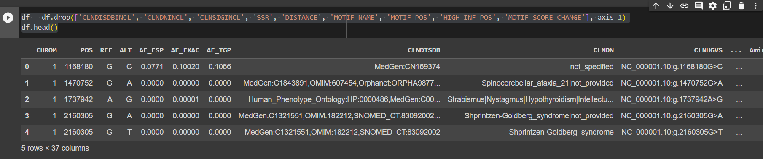
It is a part of a data cleaning process, specifically removing columns that are deemed unnecessary or redundant for the analysis or modeling at hand. The code snippet involves two steps:
Dropping columns: The df.drop() method is used to remove specified columns from a DataFrame. In this case, the following columns are being dropped:
CLNDISDBINCL: This column might contain redundant information about variants called in the ClinVar database.
CLNDNINCL: Similar to CLNDISDBINCL, this column might contain redundant information about variants included in other variant databases.
CLNSIGINCL: This column might contain redundant information about variants included in the HGNC variation database.
SSR: This column might contain information about simple sequence repeats (SSRs), which could be analyzed separately.
DISTANCE: This column might contain information about the distance between variants, which could be calculated if needed.
MOTIF_NAME: This column might contain information about the names of motifs associated with variants, which could be analyzed separately.
MOTIF_POS: This column might contain information about the positions of motifs associated with variants, which could be analyzed separately.
HIGH_INF_POS: This column might contain information about the positions of highly informative regions, which could be analyzed separately.
MOTIF_SCORE_CHANGE: This column might contain information about the change in motif scores associated with variants, which could be analyzed separately.
Displaying the head of the DataFrame: After dropping the columns, the df.head() method is used to display the first few rows of the modified DataFrame. This provides a quick overview of the remaining columns and their values.
The overall purpose of this code snippet is to streamline the DataFrame by eliminating columns that are not immediately relevant to the current analysis or modeling task. This can help improve the efficiency of data processing and reduce the amount of data that needs to be handled.

Slide 7
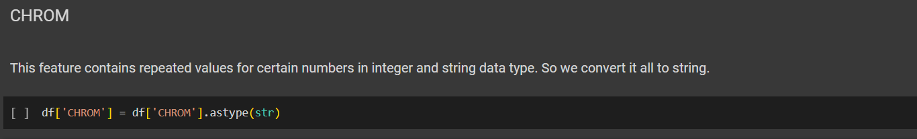
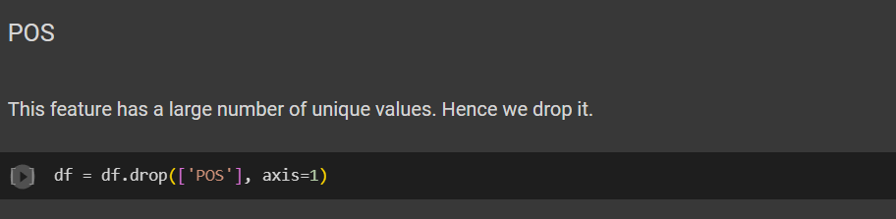
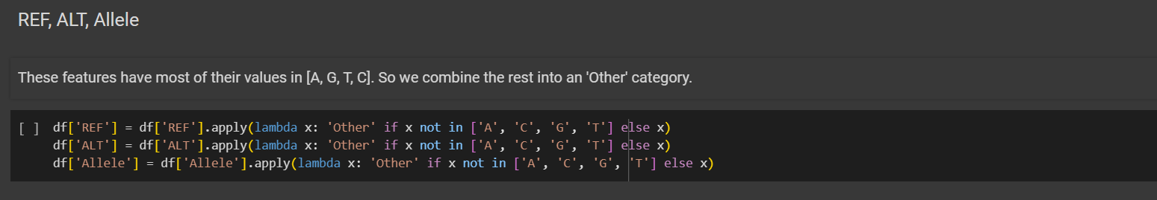
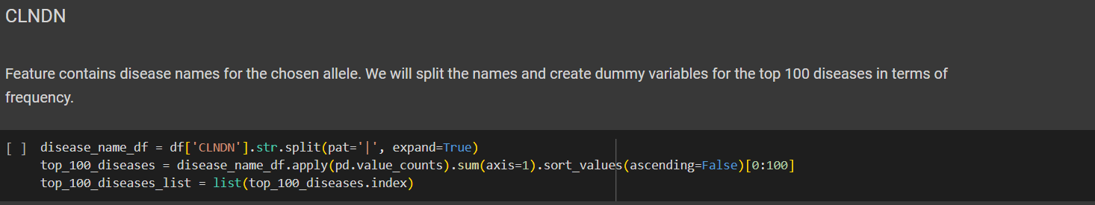

Slide 8
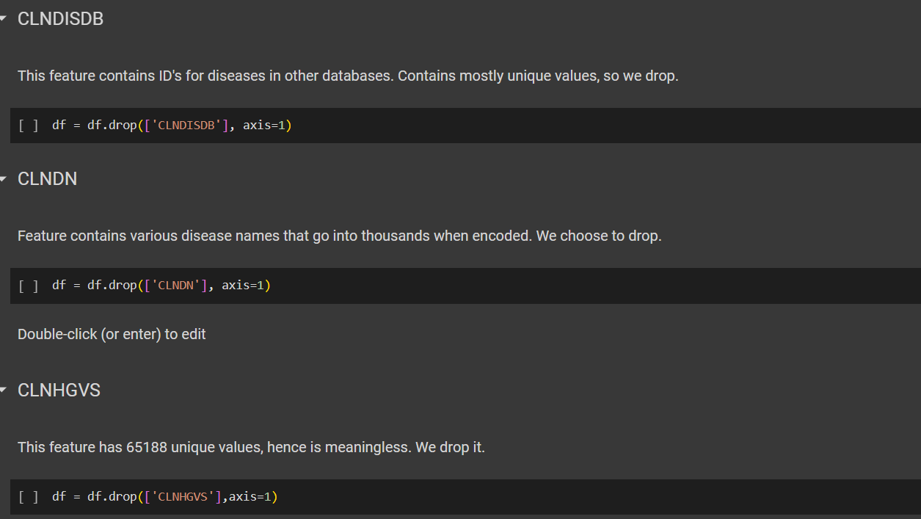

Slide 9
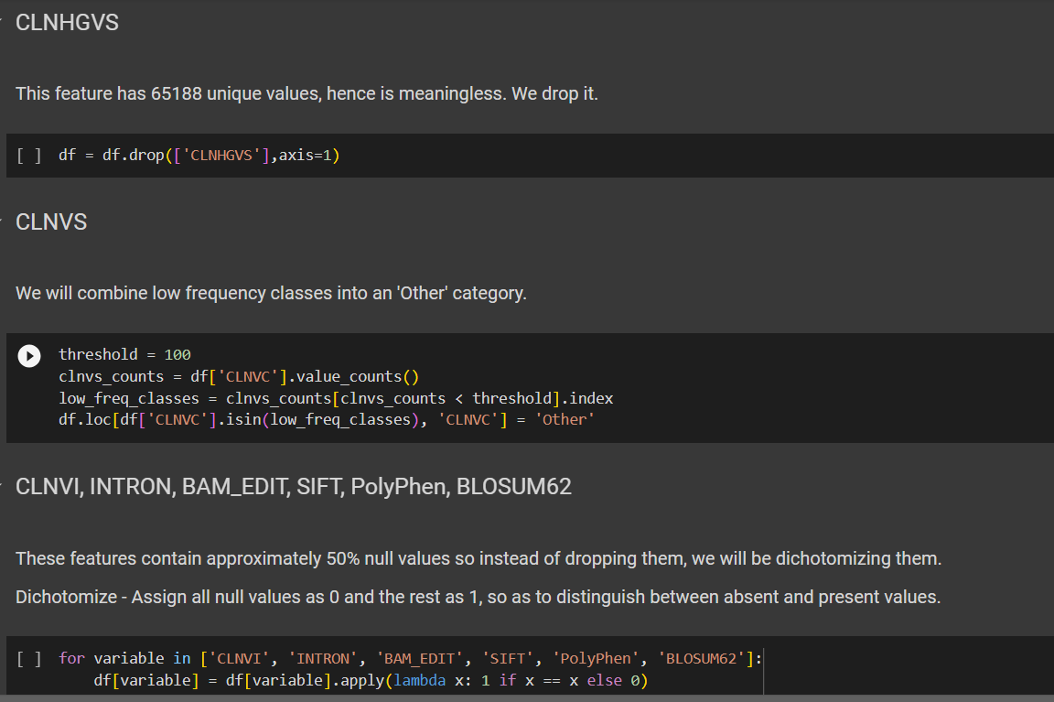
Removing a Column: The line df = df.drop(['CLNHGVS'],axis=1) removes the 'CLNHGVS' column from the DataFrame 'df'. Handling Low-Frequency Categories: The script identifies and groups categories with counts less than 100 in the 'CLNVC' column as 'Other', simplifying the dataset. Processing Categorical Variables: The script processes several categorical columns ('CLNVI', 'INTRON', 'BAM_EDIT',

Slide 10
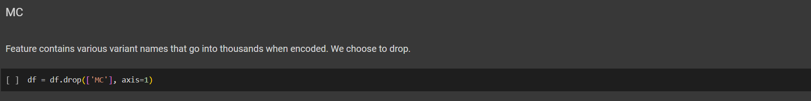
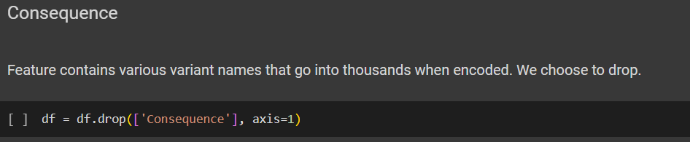
When encoding the columns the variant names go into the thousands so we decide to drop the columns.

Slide 11
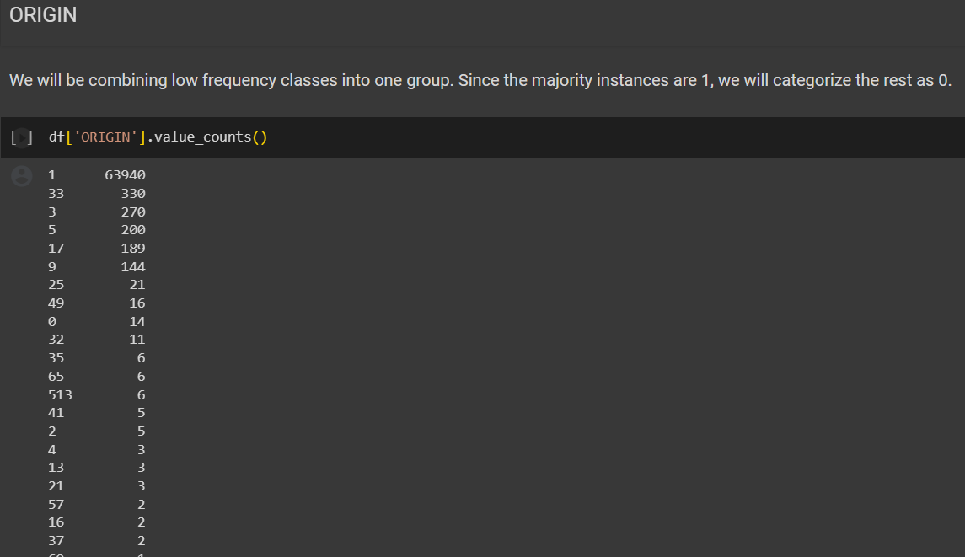
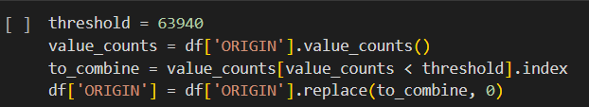
Step 1: Setting a threshold for ORIGIN values
The threshold = 63940 statement sets a threshold value of 63940. This threshold will be used to determine which ORIGIN values to combine into a single category.
Step 2: Counting the occurrences of ORIGIN values
The value_counts = df['ORIGIN'].value_counts() statement counts the number of times each unique value appears in the ORIGIN column of the DataFrame df. This results in a Series object where the index represents the unique ORIGIN values and the values represent their corresponding counts.
Step 3: Identifying values to combine
The to_combine = value_counts[value_counts < threshold].index statement identifies the ORIGIN values that have a count less than the specified threshold. This is achieved by selecting the indices of the value_counts Series where the values are less than the threshold.
Step 4: Replacing ORIGIN values with 0
The df['ORIGIN'] = df['ORIGIN'].replace(to_combine, 0) statement replaces all occurrences of the ORIGIN values identified in step 3 with the value 0. This effectively combines all low-frequency ORIGIN values into a single category represented by 0.
In summary, this code combines low-frequency ORIGIN values into a single category to reduce the number of unique values and simplify the analysis or modeling task.

Slide 12
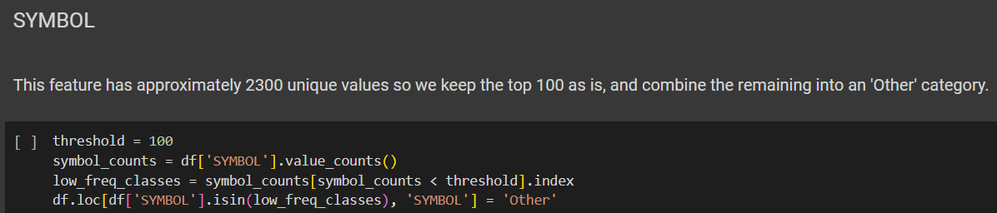
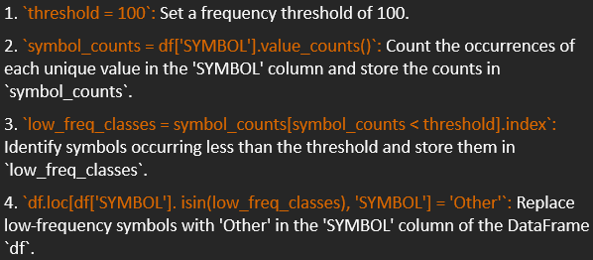
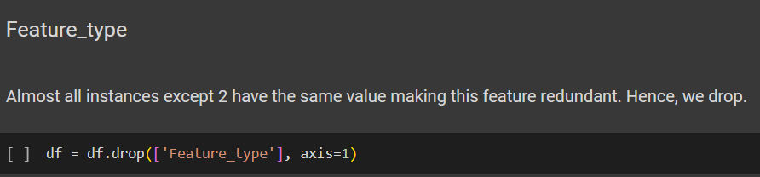

Slide 13
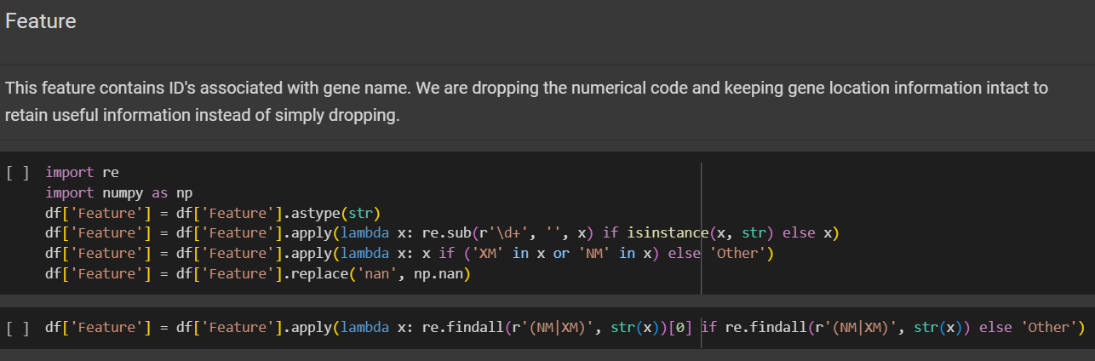
The first line imports the necessary modules, `re` and `numpy`. Then, it appears that the code converts the 'Feature' column of the DataFrame to a string type. Following that, the script uses regular expressions (`re.sub`) to remove any digits from the 'Feature' column. The next step seems to be filtering the values in the 'Feature' column based on certain conditions. If the string contains either 'XM' or 'NM', the original value is retained, otherwise, it is replaced with 'Other'.
Additionally, the script seems to be handling missing values. It replaces the string 'nan' with the NumPy representation of missing values, `np.nan`, in the 'Feature' column. The next step involves finding specific patterns within the 'Feature' column using regular expressions. It extracts either 'NM' or 'XM' patterns, depending on their presence, and assigns the result to the 'Feature' column. If no 'NM' or 'XM' patterns are found, it assigns the value 'Other' to the 'Feature' column.
Overall, this code appears to be cleaning and preprocessing the 'Feature' column of the DataFrame, potentially for further analysis or modeling purposes, by standardizing the values based on certain conditions and patterns.

Slide 14
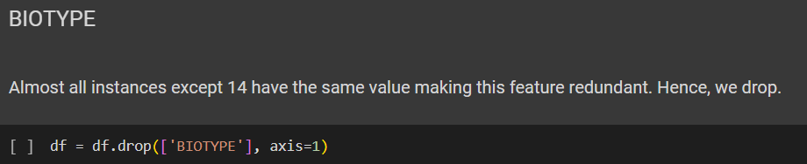
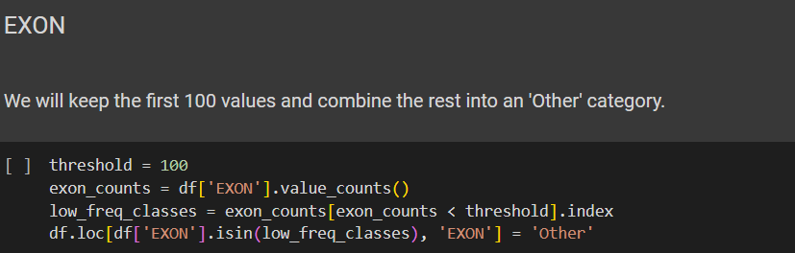
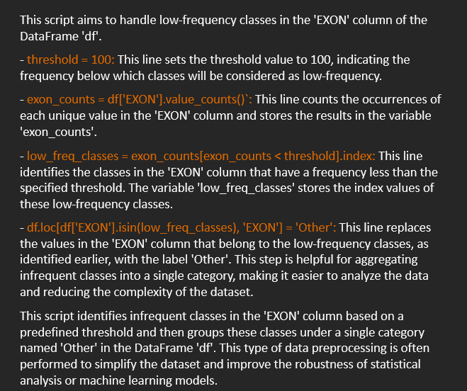

Slide 15
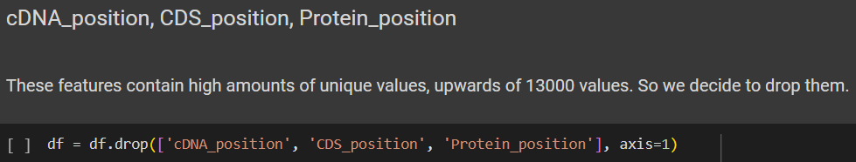
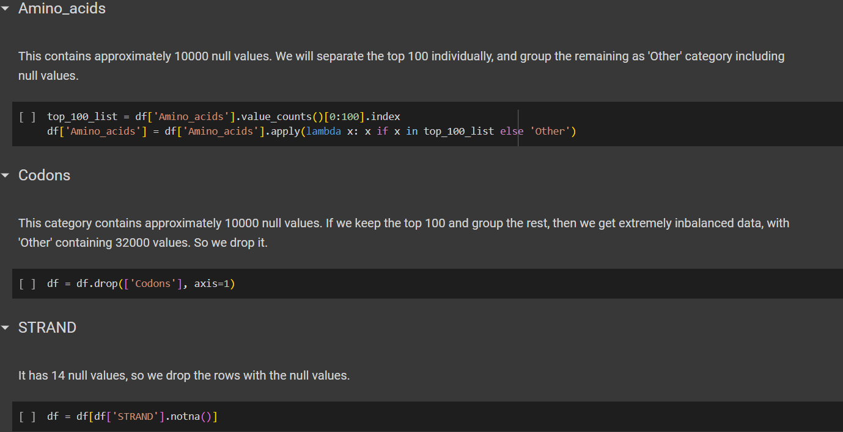

Slide 16
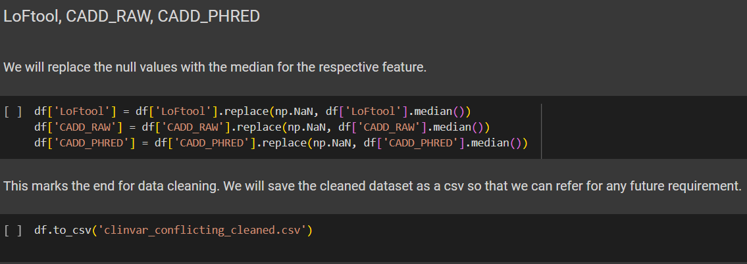
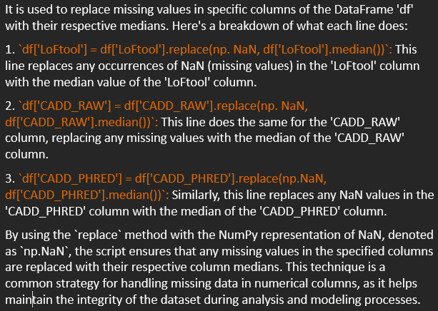

Slide 17
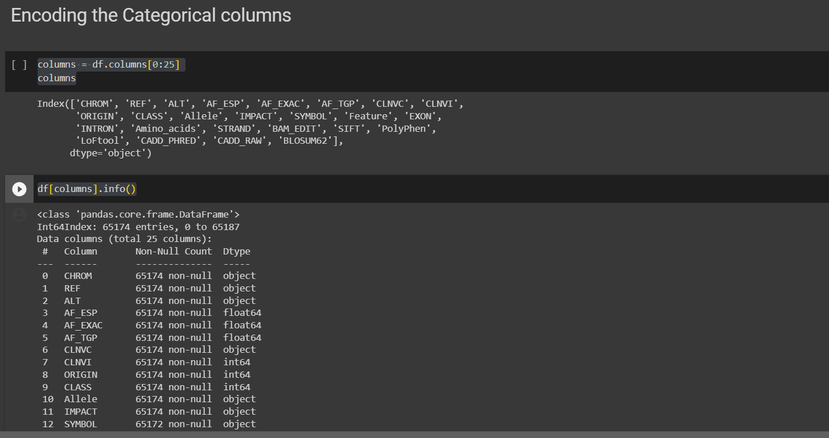
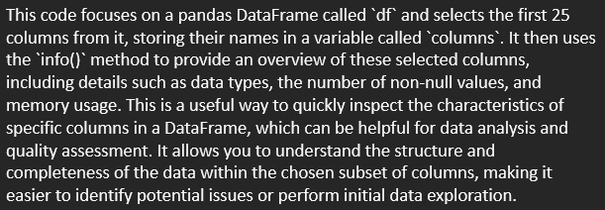

Slide 18
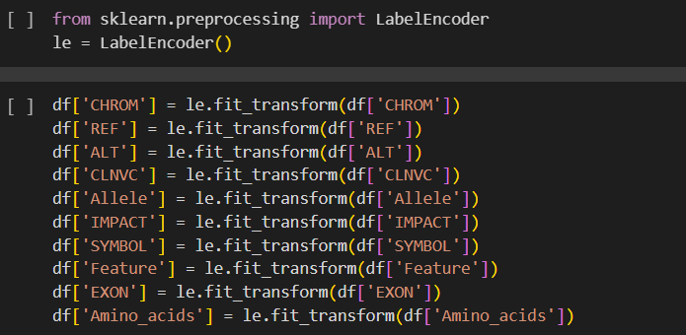
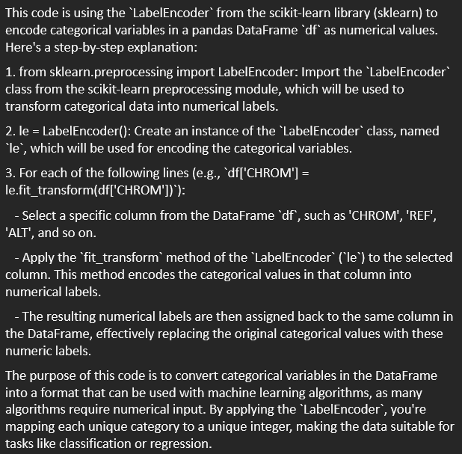

Slide 19
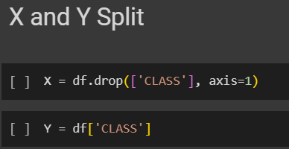
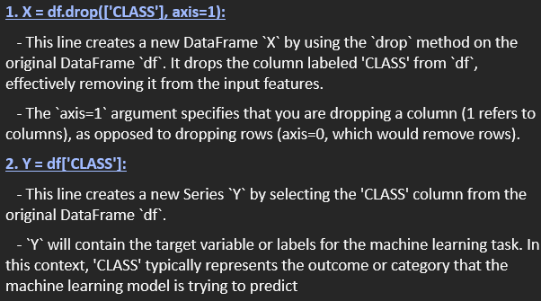

Slide 20
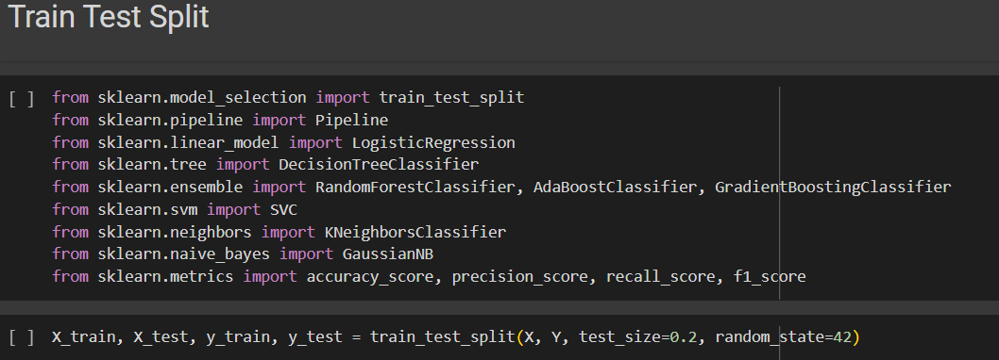
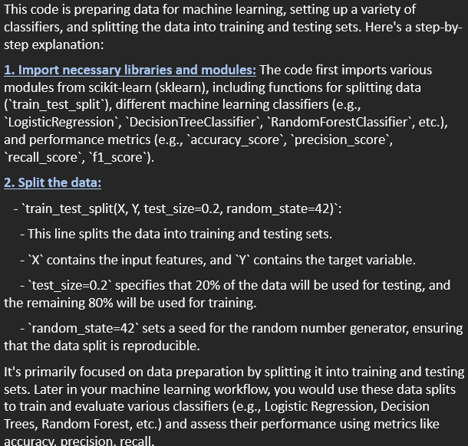

Slide 21
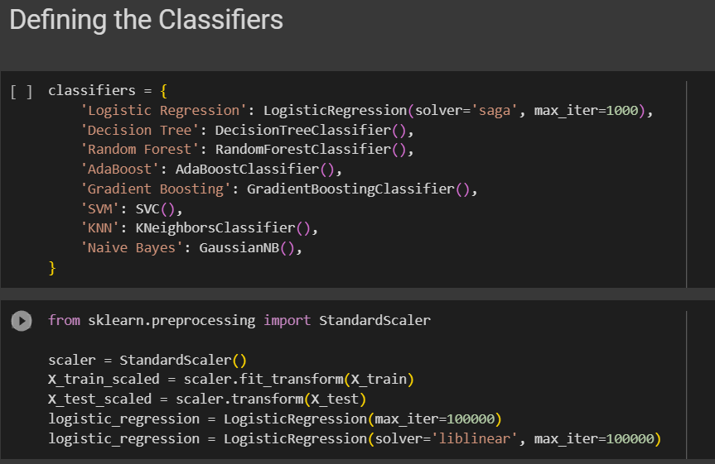
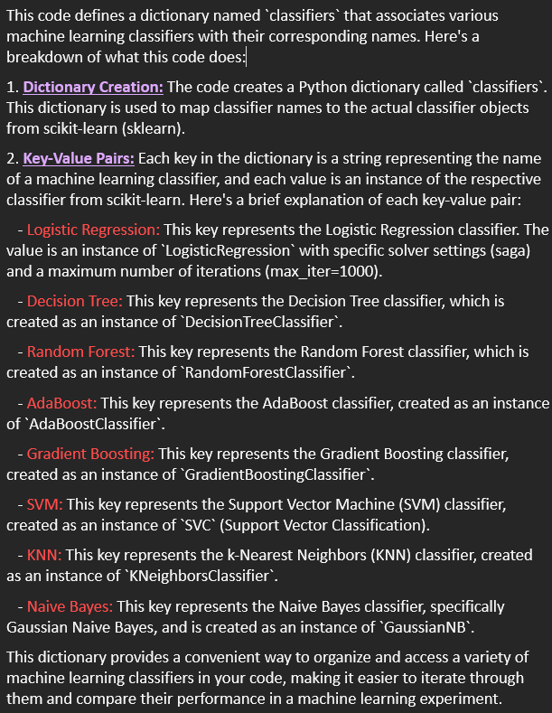
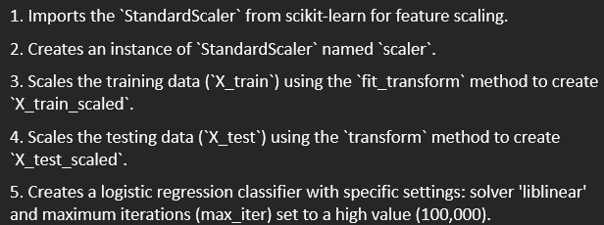

Slide 22
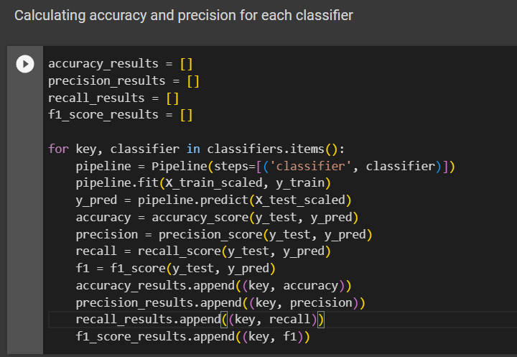
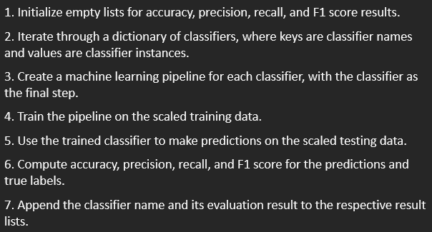

Slide 23
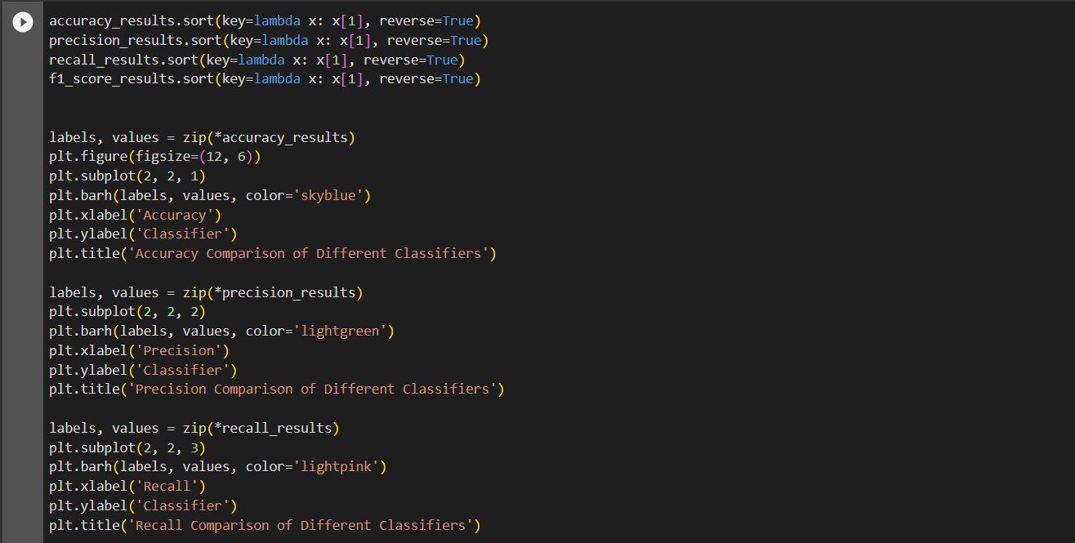
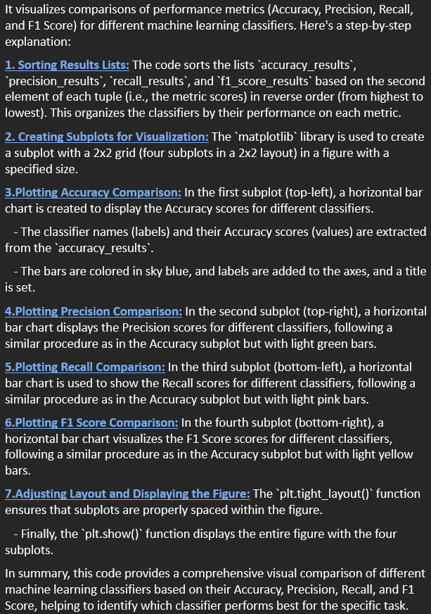
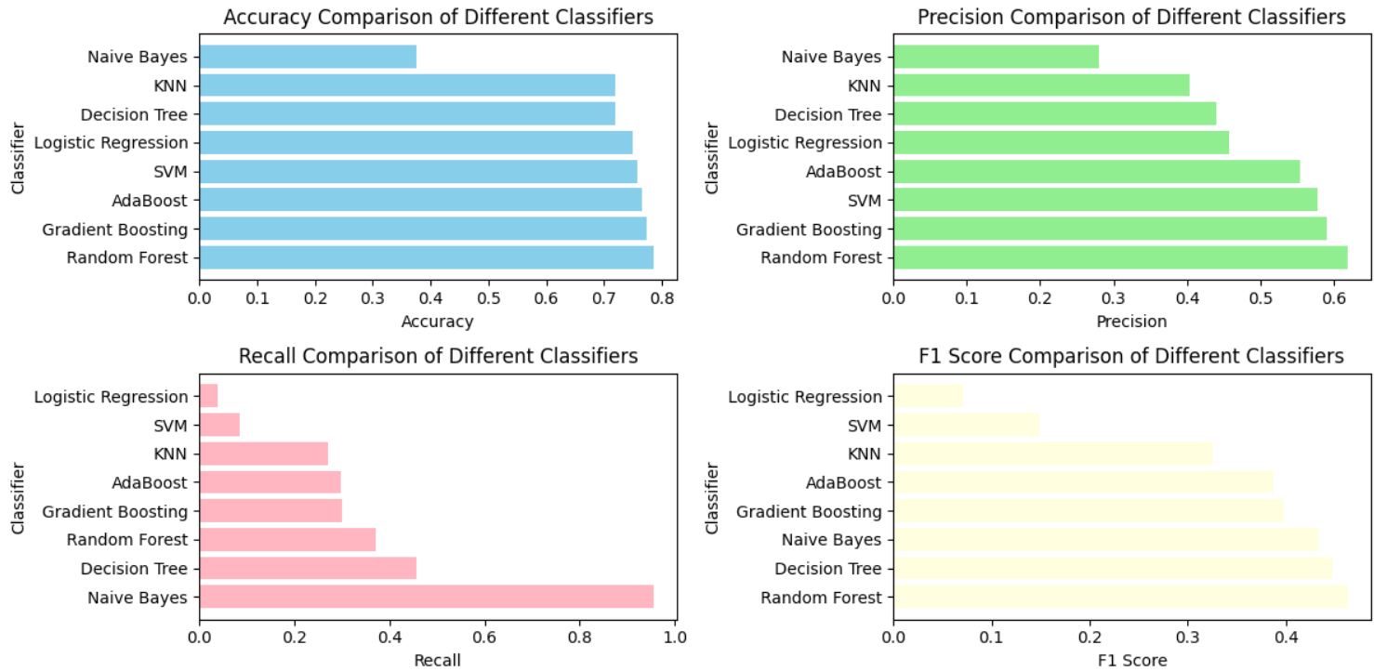
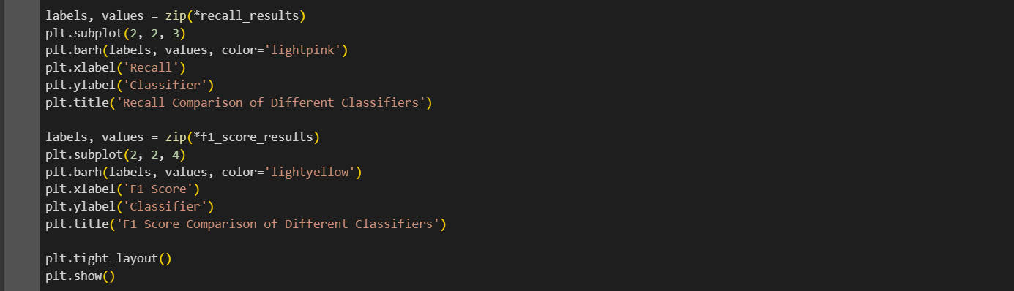

Slide 24
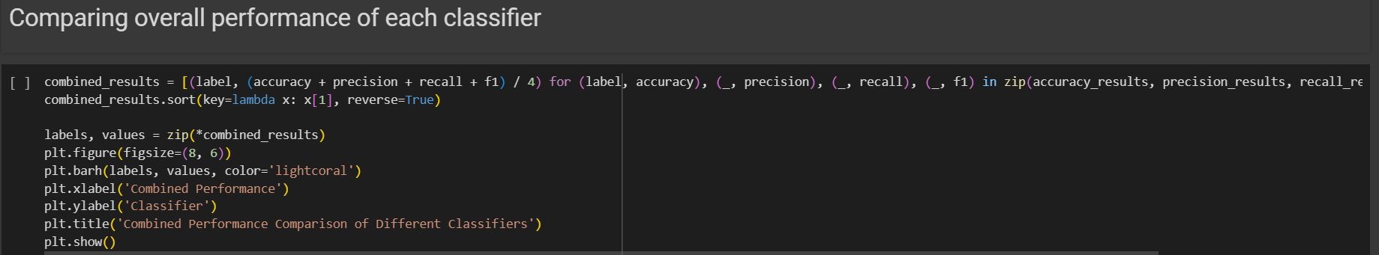
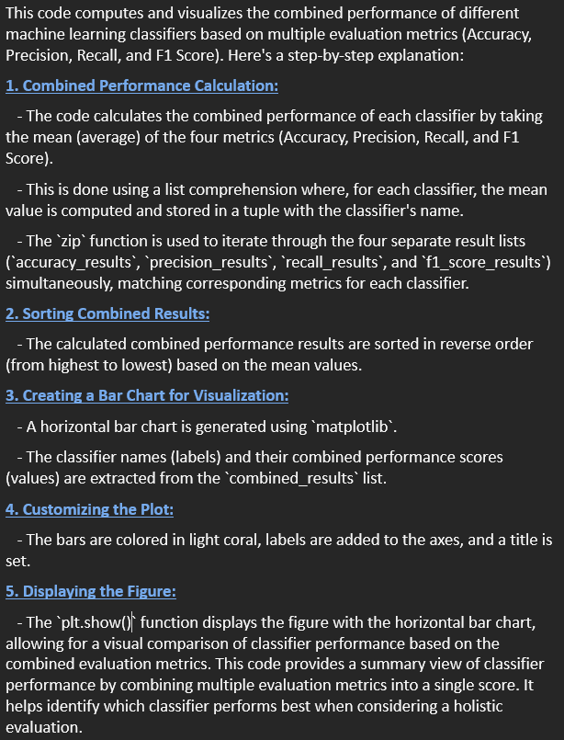
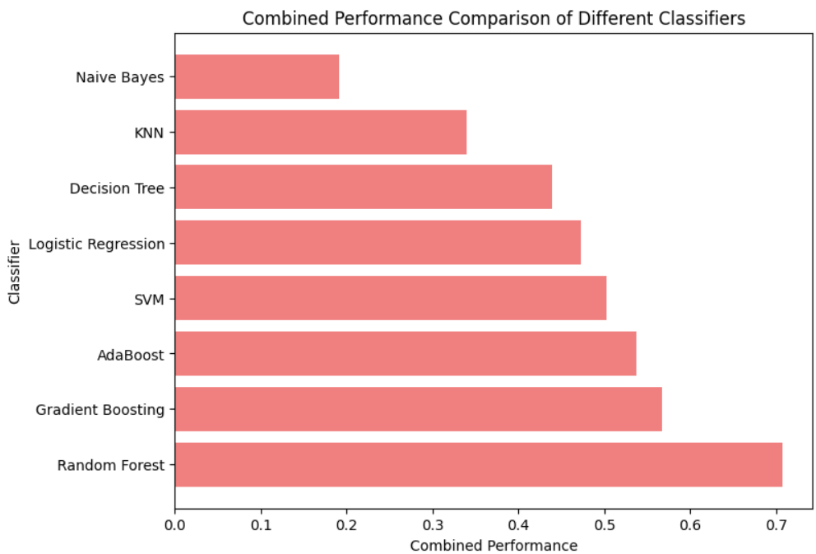

Slide 25
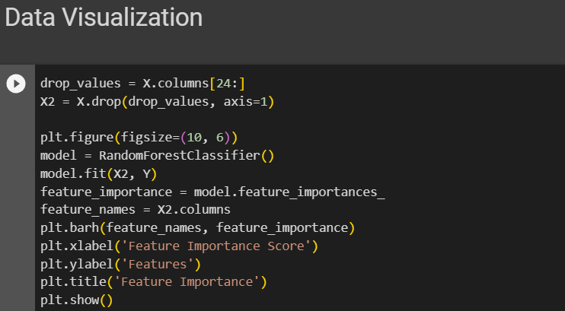
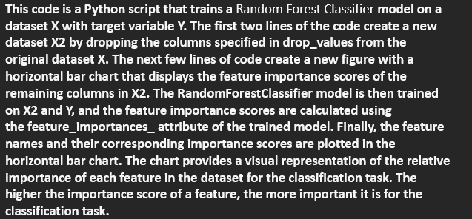
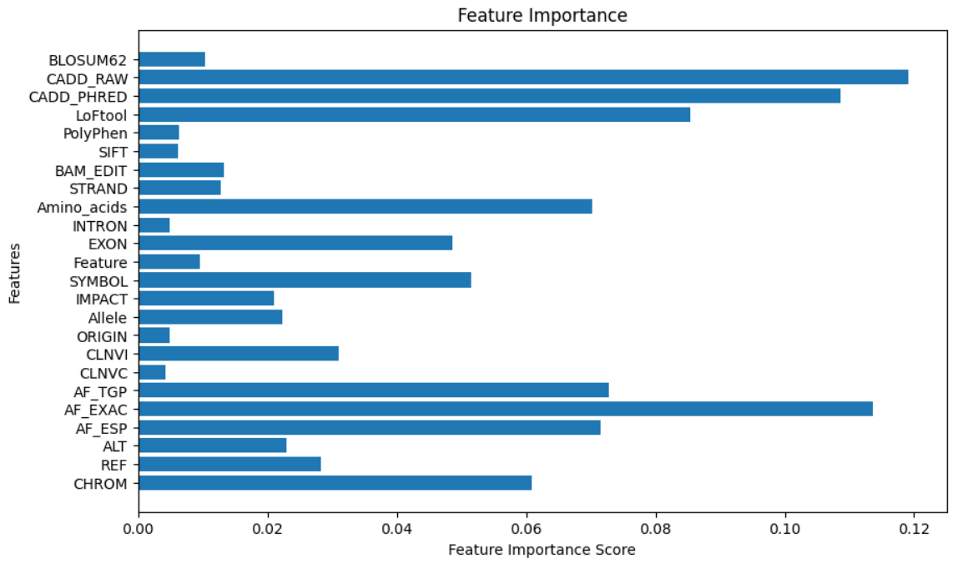

Slide 26
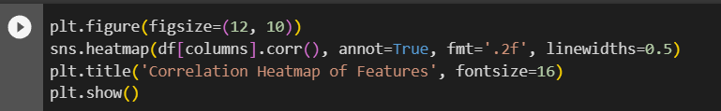




Slide 27



Slide 28



Slide 29



Slide 30






Slide 31



Step 1: Importing the required files and creating the flask app
Step 3: Utilizing the html template as front end and inputting values from the user
Step 2: Loading the pickle files

Slide 32



Step 4: User input data cleaning

Slide 33


Step 5: Encoding the data by using the pickled encoders
Step 6: Joining into a temporary variable and scaling the data using the pickled scaler
Step 7: Predicting the result using the pickled model and then displaying it on the web application
Step 8: Running the Web application via conditional statement

